Slide 1
Lecture 13: Joins Part II
Lecture 13

Slide 2
Today’s Lecture
Lecture 13
Sort-Merge Join (SMJ)
Hash Join (HJ)
The Cage Match: SMJ vs. HJ

Slide 3

1. Sort-Merge Join (SMJ)
Lecture 13 > Section 1

Slide 4
What you will learn about in this section
Lecture 13 > Section 1
Sort-Merge Join
“Backup” & Total Cost
Optimizations
ACTIVITY: Sequential Flooding

Slide 5
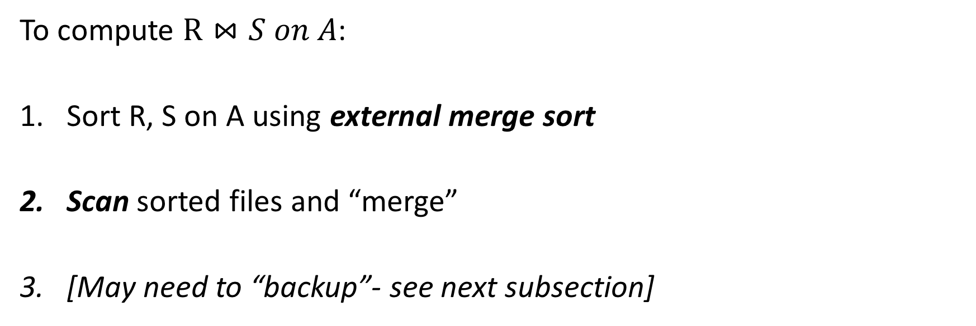
Sort Merge Join (SMJ): Basic Procedure
Lecture 13 > Section 1 > SMJ
To compute $R⋈S on A$:
Sort R, S on A using external merge sort
Scan sorted files and “merge”
[May need to “backup”- see next subsection]
Note that we are only considering equality join conditions here
Note that if R, S are already sorted on A, SMJ will be awesome!

Slide 6

SMJ Example: $R⋈S on A$with 3 page buffer
Lecture 13 > Section 1 > SMJ
For simplicity: Let each page be one tuple, and let the first value be A
We show the file HEAD, which is the next value to be read!
Disk
Main Memory
R
(0,a)
(5,b)
(3,j)
Buffer
S
(3,g)
(7,f)
(0,j)

Slide 7
SMJ Example: $R⋈S on A$with 3 page buffer
Lecture 13 > Section 1 > SMJ
1. Sort the relations R, S on the join key (first value)
Disk
Main Memory
(3,j)
(5,b)
(5,b)
(0,a)
(3,j)
R
(0,a)
Buffer
S
(7,f)
(3,g)
(0,j)
(0,j)
(7,f)
(3,g)

Slide 8
SMJ Example: $R⋈S on A$with 3 page buffer
Lecture 13 > Section 1 > SMJ
2. Scan and “merge” on join key!
Disk
Main Memory
(0,a)
(3,j)
(5,b)
R
(0,a)
Buffer
S
(0,j)
(3,g)
(7,f)
(0,j)
Output

Slide 9
SMJ Example: $R⋈S on A$with 3 page buffer
Lecture 13 > Section 1 > SMJ
2. Scan and “merge” on join key!
Disk
Main Memory
R
(0,a)
(3,j)
(5,b)
Buffer
S
(0,j)
(3,g)
(7,f)
(0,a)
(0,j)
(0,a,j)
Output

Slide 10
SMJ Example: $R⋈S on A$with 3 page buffer
Lecture 13 > Section 1 > SMJ
2. Scan and “merge” on join key!
Disk
Main Memory
(0,a)
(3,j)
(5,b)
R
(3,j)
(5,b)
Buffer
S
(0,j)
(3,g)
(7,f)
(3,g)
(7,f)
(3,j,g)
Output
(0,a,j)

Slide 11
SMJ Example: $R⋈S on A$with 3 page buffer
Lecture 13 > Section 1 > SMJ
2. Done!
Disk
Main Memory
(0,a)
3,j
5,b
R
(3,j)
(5,b)
Buffer
S
(0,j)
3,g
7,f
(3,g)
(7,f)
Output
(0,a,j)
(3,j,g)

Slide 12
What happens with duplicate join keys?
Lecture 13 > Section 1 > Backup

Slide 13
Multiple tuples with Same Join Key: “Backup”
Lecture 13 > Section 1 > Backup
1. Start with sorted relations, and begin scan / merge…
Disk
Main Memory
(0,a)
3,j
5,b
R
(0,a)
(0,j)
(0,b)
Buffer
S
(0,j)
(0,j)
3,g
7,f
(0,g)
(7,f)
Output

Slide 14
Multiple tuples with Same Join Key: “Backup”
Lecture 13 > Section 1 > Backup
1. Start with sorted relations, and begin scan / merge…
Disk
Main Memory
(0,a)
3,j
5,b
R
(0,j)
(0,b)
Buffer
S
(0,j)
3,g
7,f
(0,g)
(7,f)
(0,a)
(0,j)
(0,a,j)
Output

Slide 15
Multiple tuples with Same Join Key: “Backup”
Lecture 13 > Section 1 > Backup
1. Start with sorted relations, and begin scan / merge…
Disk
Main Memory
(0,a)
(0,j)
5,b
R
(0,j)
(0,b)
Buffer
S
(0,j)
(0,g)
7,f
(0,g)
(7,f)
(0,a)
(0,a,g)
Output
(0,a,j)

Slide 16
Multiple tuples with Same Join Key: “Backup”
Lecture 13 > Section 1 > Backup
1. Start with sorted relations, and begin scan / merge…
Disk
Main Memory
(0,a)
0,j
5,b
R
(0,j)
(0,b)
Buffer
S
(0,j)
0,g
7,f
(0,j)
(0,g)
(7,f)
(0,j)
Output
(0,a,j)
(0,a,g)
Have to “backup” in the scan of S and read tuple we’ve already read!

Slide 17
Backup
Lecture 13 > Section 1 > Backup
At best, no backup → scan takes P(R) + P(S) reads
For ex: if no duplicate values in join attribute
At worst (e.g. full backup each time), scan could take P(R) * P(S) reads!
For ex: if all duplicate values in join attribute, i.e. all tuples in R and S have the same value for the join attribute
Roughly: For each page of R, we’ll have to back up and read each page of S…
Often not that bad however, plus we can:
Leave more data in buffer (for larger buffers)
Can “zig-zag” (see animation)

Slide 18
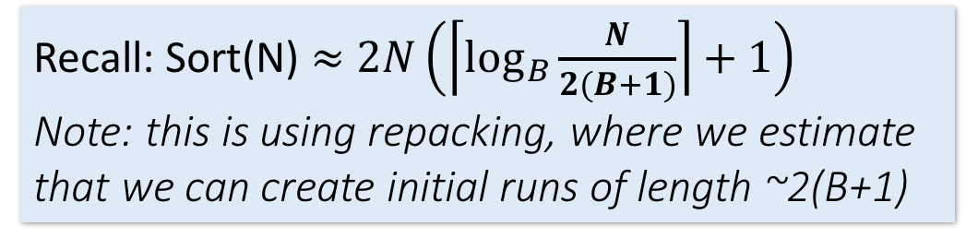
SMJ: Total cost
Lecture 13 > Section 1 > Backup
Cost of SMJ is cost of sorting R and S…
Plus the cost of scanning: ~P(R)+P(S)
Because of backup: in worst case P(R)*P(S); but this would be very unlikely
Plus the cost of writing out: ~P(R)+P(S) but in worst case T(R)*T(S)
~ Sort(P(R)) + Sort(P(S)) + P(R) + P(S) + OUT
Recall: Sort(N) $≈$ $2N\left(\left\lceil \log_{B}{\frac{N}{2(B+1)}}\right\rceil +1\right)$
Note: this is using repacking, where we estimate that we can create initial runs of length ~2(B+1)

Slide 19
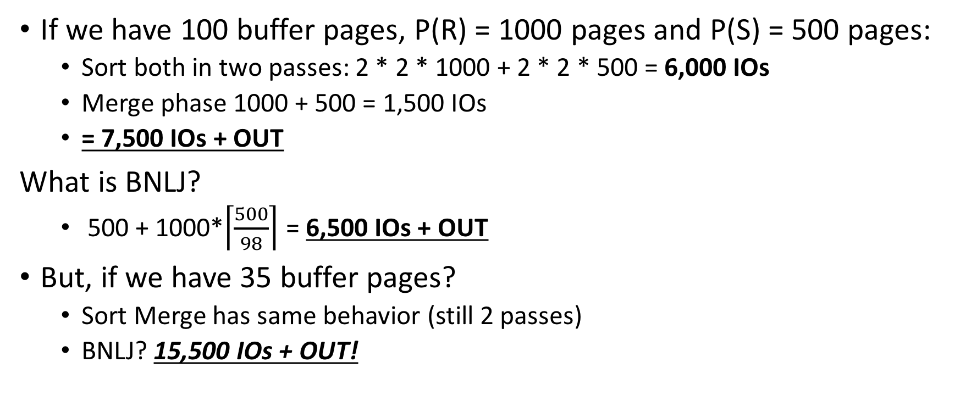
SMJ vs. BNLJ: Steel Cage Match
Lecture 13 > Section 1 > Backup
If we have 100 buffer pages, P(R) = 1000 pages and P(S) = 500 pages:
Sort both in two passes: 2 * 2 * 1000 + 2 * 2 * 500 = 6,000 IOs
Merge phase 1000 + 500 = 1,500 IOs
= 7,500 IOs + OUT
What is BNLJ?
500 + 1000*$\left\lceil \frac{500}{98}\right\rceil$ = 6,500 IOs + OUT
But, if we have 35 buffer pages?
Sort Merge has same behavior (still 2 passes)
BNLJ? 15,500 IOs + OUT!
SMJ is ~ linear vs. BNLJ is quadratic…
But it’s all about the memory.

Slide 20
A Simple Optimization: Merges Merged!
Lecture 13 > Section 1 > Backup
Given B+1 buffer pages
SMJ is composed of a sort phase and a merge phase
During the sort phase, run passes of external merge sort on R and S
Suppose at some point, R and S have <= B (sorted) runs in total
We could do two merges (for each of R & S) at this point, complete the sort phase, and start the merge phase…
OR, we could combine them: do one B-way merge and complete the join!

Slide 21
Un-Optimized SMJ
Lecture 13 > Section 1 > Backup
Given B+1 buffer pages
Unsorted input relations
Sort Phase
(Ext. Merge Sort)
R
S
Split & sort
Split & sort
Merge
Merge
Merge
Merge
Merge / Join Phase
Joined output file created!

Slide 22
Simple SMJ Optimization
Lecture 13 > Section 1 > Backup
Given B+1 buffer pages
Unsorted input relations
Sort Phase
(Ext. Merge Sort)
R
S
Split & sort
Split & sort
Merge
Merge
<= B total runs
B-Way Merge / Join
Merge / Join Phase
Joined output file created!

Slide 23
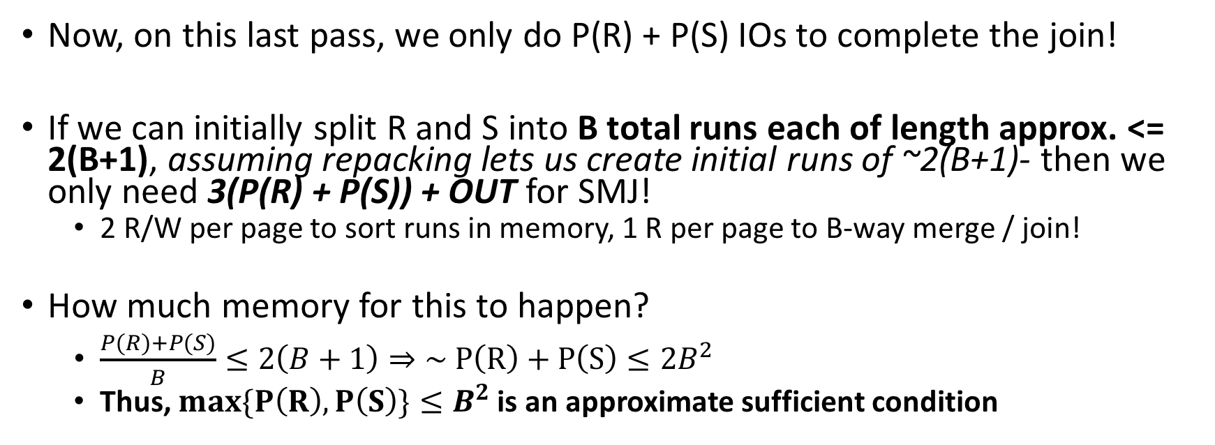
Simple SMJ Optimization
Lecture 13 > Section 1 > Backup
Given B+1 buffer pages
Now, on this last pass, we only do P(R) + P(S) IOs to complete the join!
If we can initially split R and S into B total runs each of length approx. <= 2(B+1), assuming repacking lets us create initial runs of ~2(B+1)- then we only need 3(P(R) + P(S)) + OUT for SMJ!
2 R/W per page to sort runs in memory, 1 R per page to B-way merge / join!
How much memory for this to happen?
$\frac{P\left(R\right)+P(S)}{B}≤2\left(B+1\right)⇒\sim P\left(R\right)+P\left(S\right)≤2B^{2}$
Thus, $max\{P\left(R\right), P\left(S\right)\}≤B^{2}$ is an approximate sufficient condition
See Lecture 13, Slide 13-14 – to clarify this slide.
If the larger of R,S has <= B² pages, then SMJ costs 3(P(R)+P(S)) + OUT!

Slide 24
Takeaway points from SMJ
Lecture 13 > Section 1 > Summary
If input already sorted on join key, skip the sorts.
SMJ is basically linear.
Nasty but unlikely case: Many duplicate join keys.
SMJ needs to sort both relations
If max { P(R), P(S) } < B² then cost is 3(P(R)+P(S)) + OUT

Slide 25
Bonus questions.
Q1: Fast dog.
If max {P(R), P(S)} < B² then SMJ takes 3(P(R) + P(S)) + OUT
What is the similar condition to obtain 5(P(R) + P(S)) + OUT?
What is the condition for (2k+1)(P(R) + P(S)) + OUT
Q2: BNLJ V. SMJ
Under what conditions will BNLJ outperform SMJ?
Size of R, S and # of buffer pages
Discuss! And We’ll put up a google form.

Slide 26

2. Hash Join (HJ)
Lecture 13 > Section 2

Slide 27
What you will learn about in this section
Lecture 13 > Section 2
Hash Join
Memory requirements

Slide 28
Recall: Hashing
Lecture 13 > Section 2 > HJ
Magic of hashing:
A hash function h_{B} maps into [0,B-1]
And maps nearly uniformly
A hash collision is when x != y but h_{B}(x) = h_{B}(y)
Note however that it will never occur that x = y but h_{B}(x) != h_{B}(y)
We hash on an attribute A, so our has function is h_{B}(t) has the form h_{B}(t.A).
Collisions may be more frequent.

Slide 29
Recall: Mad Hash Collisions
Lecture 13 > Section 2 > HJ
Say something here to justify this slide’s existence? [TODO]

Slide 30
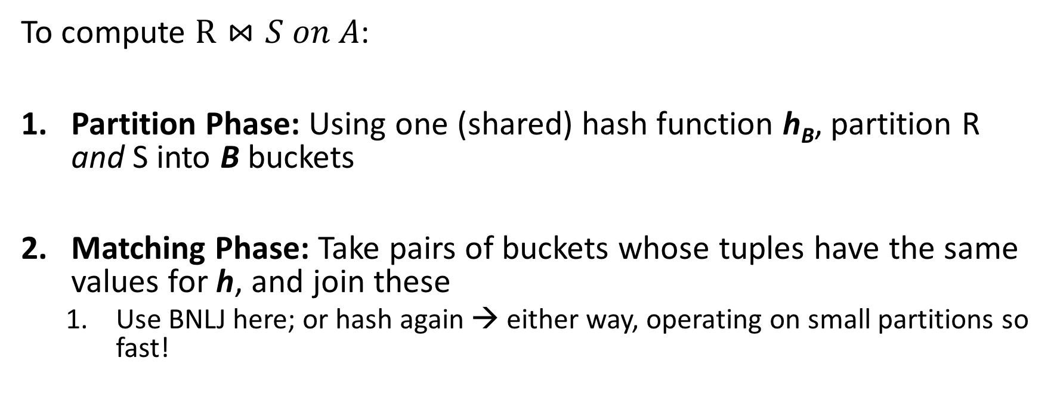
Hash Join: High-level procedure
Lecture 13 > Section 2 > HJ
Note again that we are only considering equality constraints here
To compute $R⋈S on A$:
Partition Phase: Using one (shared) hash function h_{B}, partition R and S into B buckets
Matching Phase: Take pairs of buckets whose tuples have the same values for h, and join these
Use BNLJ here; or hash again → either way, operating on small partitions so fast!
We decompose the problem using h_{B}, then complete the join

Slide 31
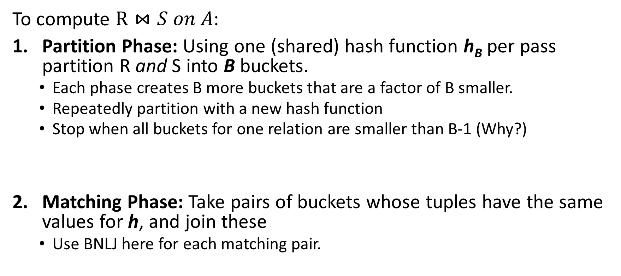
Hash Join: High-level procedure
Lecture 13 > Section 2 > HJ
To compute $R⋈S on A$:
Partition Phase: Using one (shared) hash function h_{B} per pass partition R and S into B buckets.
Each phase creates B more buckets that are a factor of B smaller.
Repeatedly partition with a new hash function
Stop when all buckets for one relation are smaller than B-1 (Why?)
Matching Phase: Take pairs of buckets whose tuples have the same values for h, and join these
Use BNLJ here for each matching pair.
Each pass takes 2(P(R) + P(S))
P(R) + P(S) + OUT
We decompose the problem using h_{B}, then complete the join

Slide 32
Hash Join: High-level procedure
Lecture 13 > Section 2 > HJ
1. Partition Phase: Using one (shared) hash function h_{B}, partition R and S into B buckets
Disk
Disk
Note our new convention: pages each have two tuples (one per row)
(0,a)
(0,a)
(0,j)
R
(0,a)
(0,a)
(3,j)
(0,j)
(3,b)
R₁
h_{B}
R₂
(3,j)
(3,b)
S
(0,a)
(0,j)
(5,b)
S₁
(0,a)
(0,j)
More detail in a second…
S₂
(5,b)
(5,b)

Slide 33
Hash Join: High-level procedure
Lecture 13 > Section 2 > HJ
2. Matching Phase: Take pairs of buckets whose tuples have the same values for h_{B}, and join these
Disk
Disk
(0,a)
(0,a)
(0,j)
R
(0,a)
(0,a)
(3,j)
(0,j)
(3,b)
R₁
h_{B}
Join matching buckets
R₂
(3,j)
(3,b)
S
(0,a)
(0,j)
(5,b)
S₁
(0,a)
(0,j)
S₂
(5,b)
(5,b)

Slide 34
Hash Join: High-level procedure
Lecture 13 > Section 2 > HJ
2. Matching Phase: Take pairs of buckets whose tuples have the same values for h_{B}, and join these
Disk
Disk
(0,a)
(0,a)
(0,j)
R
(0,a)
(0,a)
(3,j)
(0,j)
(3,b)
R₁
h_{B}
(3,j)
(3,b)
Don’t have to join the others! E.g. (S₁ and R₂)!
R₂
S
(0,a)
(0,j)
(5,b)
S₁
(0,a)
(0,j)
S₂
(5,b)
(5,b)

Slide 35
Hash Join Phase 1: Partitioning
Lecture 13 > Section 2 > HJ
Goal: For each relation, partition relation into buckets such that if h_{B}(t.A) = h_{B}(t’.A) they are in the same bucket
Given B+1 buffer pages, we partition into B buckets:
We use B buffer pages for output (one for each bucket), and 1 for input
The “dual” of sorting.
For each tuple t in input, copy to buffer page for h_{B}(t.A)
When page fills up, flush to disk.

Slide 36
How big are the resulting buckets?
Lecture 13 > Section 2 > HJ
Given B+1 buffer pages
Given N input pages, we partition into B buckets:
→ Ideally our buckets are each of size ~ N/B pages
What happens if there are hash collisions?
Buckets could be > N/B
We’ll do several passes…
What happens if there are duplicate join keys?
Nothing we can do here… could have some skew in size of the buckets

Slide 37
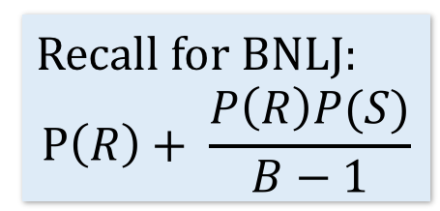
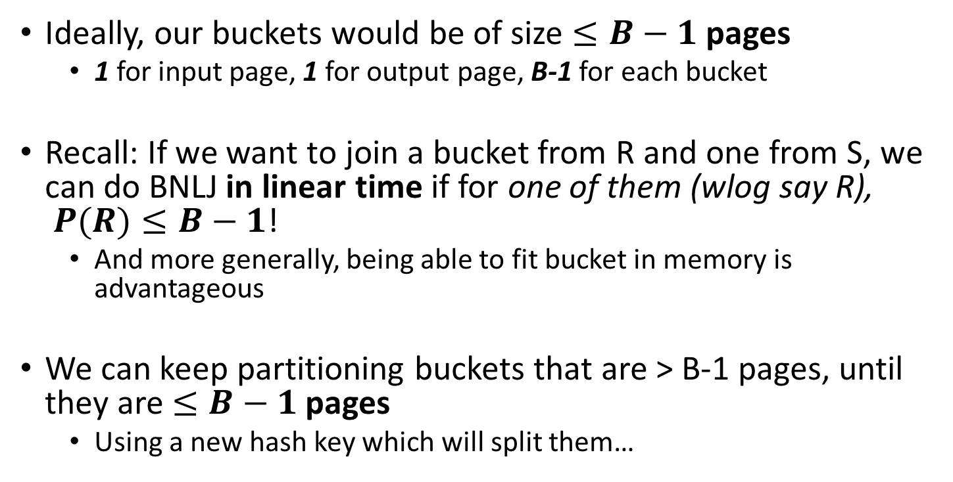
How big do we want the resulting buckets?
Lecture 13 > Section 2 > HJ
Given B+1 buffer pages
Ideally, our buckets would be of size $≤B−1$ pages
1 for input page, 1 for output page, B-1 for each bucket
Recall: If we want to join a bucket from R and one from S, we can do BNLJ in linear time if for one of them (wlog say R), $P(R)≤B−1$!
And more generally, being able to fit bucket in memory is advantageous
We can keep partitioning buckets that are > B-1 pages, until they are $≤B−1$ pages
Using a new hash key which will split them…
Recall for BNLJ:
$$P\left(R\right)+ \frac{P\left(R\right)P(S)}{B−1}$$
We’ll call each of these a “pass” again…

Slide 38
Hash Join Phase 1: Partitioning
Lecture 13 > Section 2 > HJ
Given B+1 = 3 buffer pages
We partition into B = 2 buckets using hash function h₂ so that we can have one buffer page for each partition (and one for input)
Disk
For simplicity, we’ll look at partitioning one of the two relations- we just do the same for the other relation!
(5,b)
(5,a)
(0,j)
(3,j)
(0,j)
R
(0,a)
(3,a)
Recall: our goal will be to get B = 2 buckets of size <= B-1 → 1 page each

Slide 39
Hash Join Phase 1: Partitioning
Lecture 13 > Section 2 > HJ
Given B+1 = 3 buffer pages
1. We read pages from R into the “input” page of the buffer…
Disk
Main Memory
(5,b)
(5,a)
(0,j)
(3,j)
(0,j)
R
Buffer
(0,a)
(3,a)
Input page
0
1
Output (bucket) pages

Slide 40
Hash Join Phase 1: Partitioning
Lecture 13 > Section 2 > HJ
Given B+1 = 3 buffer pages
2. Then we use hash function h₂ to sort into the buckets, which each have one page in the buffer
Disk
Main Memory
h₂(0) = 0
R
(5,b)
(5,a)
(0,j)
(3,j)
(0,j)
Buffer
(3,a)
(0,a)
(3,a)
(0,a)
Input page
0
1
Output (bucket) pages

Slide 41
Hash Join Phase 1: Partitioning
Lecture 13 > Section 2 > HJ
Given B+1 = 3 buffer pages
2. Then we use hash function h₂ to sort into the buckets, which each have one page in the buffer
Disk
Main Memory
h₂(3) = 1
R
(5,b)
(5,a)
(0,j)
(3,j)
(0,j)
Buffer
(3,a)
(0,a)
(3,a)
Input page
0
1
Output (bucket) pages

Slide 42
Hash Join Phase 1: Partitioning
Lecture 13 > Section 2 > HJ
Given B+1 = 3 buffer pages
3. We repeat until the buffer bucket pages are full…
Disk
Main Memory
R
(5,b)
(5,a)
(0,j)
(3,j)
(0,j)
Buffer
(0,a)
(3,a)
Input page
0
1
Output (bucket) pages

Slide 43
Hash Join Phase 1: Partitioning
Lecture 13 > Section 2 > HJ
Given B+1 = 3 buffer pages
3. We repeat until the buffer bucket pages are full…
Disk
Main Memory
h₂(3) = 1
R
(5,b)
(5,a)
(0,j)
Buffer
(3,j)
(0,j)
(3,a)
(3,j)
(0,j)
(0,a)
(3,a)
Input page
0
1
Output (bucket) pages

Slide 44
Hash Join Phase 1: Partitioning
Lecture 13 > Section 2 > HJ
Given B+1 = 3 buffer pages
3. We repeat until the buffer bucket pages are full…
Disk
Main Memory
h₂(0) = 0
R
(5,b)
(5,a)
(0,j)
Buffer
(0,a)
(0,j)
(3,a)
(3,j)
(0,j)
(0,a)
(3,a)
Input page
0
1
Output (bucket) pages

Slide 45
Hash Join Phase 1: Partitioning
Lecture 13 > Section 2 > HJ
Given B+1 = 3 buffer pages
3. We repeat until the buffer bucket pages are full… then flush to disk
Disk
Main Memory
R
(5,b)
(5,a)
(0,j)
Buffer
B0
(0,a)
(0,j)
(3,a)
(3,j)
B1
Input page
0
1
Output (bucket) pages

Slide 46
Hash Join Phase 1: Partitioning
Lecture 13 > Section 2 > HJ
Given B+1 = 3 buffer pages
3. We repeat until the buffer bucket pages are full… then flush to disk
Disk
Main Memory
R
(5,b)
(5,a)
(0,j)
Buffer
(0,a)
(0,j)
B0
(3,a)
(3,j)
Input page
B1
0
1
Output (bucket) pages

Slide 47
Hash Join Phase 1: Partitioning
Lecture 13 > Section 2 > HJ
Given B+1 = 3 buffer pages
Note that collisions can occur!
Collision!!!
Disk
Main Memory
h₂(5) = h₂(3) = 1
h₂(5) = 1
R
(5,b)
Buffer
(0,a)
(0,j)
(0,j)
(5,a)
B0
(5,a)
(0,j)
(3,a)
(3,j)
Input page
B1
0
1
Output (bucket) pages

Slide 48
Hash Join Phase 1: Partitioning
Lecture 13 > Section 2 > HJ
Given B+1 = 3 buffer pages
Finish this pass…
Disk
Main Memory
h₂(0) = 0
R
(5,b)
Buffer
(0,a)
(0,j)
(0,j)
(0,j)
(5,a)
B0
(3,a)
(3,j)
Input page
B1
0
1
Output (bucket) pages

Slide 49
Hash Join Phase 1: Partitioning
Lecture 13 > Section 2 > HJ
Given B+1 = 3 buffer pages
Finish this pass…
Disk
Main Memory
R
(5,b)
Buffer
(0,a)
(0,j)
(0,j)
(5,a)
B0
(3,a)
(3,j)
Input page
B1
0
1
Output (bucket) pages

Slide 50
Hash Join Phase 1: Partitioning
Lecture 13 > Section 2 > HJ
Given B+1 = 3 buffer pages
Finish this pass…
Collision!!!
Disk
Main Memory
h₂(5) = h₂(3) = 1
h₂(5) = 1
R
Buffer
(0,a)
(0,j)
(5,b)
(0,j)
(5,a)
B0
(5,a)
(5,b)
(3,a)
(3,j)
Input page
B1
0
1
Output (bucket) pages

Slide 51
Hash Join Phase 1: Partitioning
Lecture 13 > Section 2 > HJ
Given B+1 = 3 buffer pages
Finish this pass…
Disk
Main Memory
R
Buffer
(0,a)
(0,j)
(0,j)
(5,a)
(5,b)
B0
(3,a)
(3,j)
Input page
B1
0
1
Output (bucket) pages

Slide 52
Hash Join Phase 1: Partitioning
Lecture 13 > Section 2 > HJ
Given B+1 = 3 buffer pages
We wanted buckets of size B-1 = 1… however we got larger ones due to:
Disk
(0,a)
(0,j)
(0,j)
(1) Duplicate join keys
B0
(3,a)
(3,j)
(5,a)
(5,b)
(2) Hash collisions
B1

Slide 53
Hash Join Phase 1: Partitioning
Lecture 13 > Section 2 > HJ
Given B+1 = 3 buffer pages
To take care of larger buckets caused by (2) hash collisions, we can just do another pass!
Disk
(0,a)
(0,j)
(0,j)
What hash function should we use?
B0
(3,a)
(3,j)
(5,a)
(5,b)
B1
Do another pass with a different hash function, h’_{2,} ideally such that:
h’₂(3) != h’₂(5)

Slide 54
Hash Join Phase 1: Partitioning
Lecture 13 > Section 2 > HJ
Given B+1 = 3 buffer pages
To take care of larger buckets caused by (2) hash collisions, we can just do another pass!
Disk
(0,a)
(0,j)
(0,j)
What hash function should we use?
B0
(3,a)
(3,j)
B1
Do another pass with a different hash function, h’_{2,} ideally such that:
h’₂(3) != h’₂(5)
(5,a)
(5,b)
B2

Slide 55
Hash Join Phase 1: Partitioning
Lecture 13 > Section 2 > HJ
Given B+1 = 3 buffer pages
What about duplicate join keys? Unfortunately this is a problem… but usually not a huge one.
Disk
(0,a)
(0,j)
(0,j)
B0
We call this unevenness in the bucket size skew
(3,a)
(3,j)
B1
(5,a)
(5,b)
B2

Slide 56
Now that we have partitioned R and S…
Lecture 13 > Section 2 > HJ

Slide 57
Hash Join Phase 2: Matching
Lecture 13 > Section 2 > HJ
Now, we just join pairs of buckets from R and S that have the same hash value to complete the join!
Disk
Disk
(0,a)
(0,a)
(0,j)
R
(0,a)
(0,a)
(3,j)
(0,j)
(3,b)
R₁
h_{B}
Join matching buckets
R₂
(3,j)
(3,b)
S
(0,a)
(0,j)
(5,b)
S₁
(0,a)
(0,j)
S₂
(5,b)
(5,b)

Slide 58

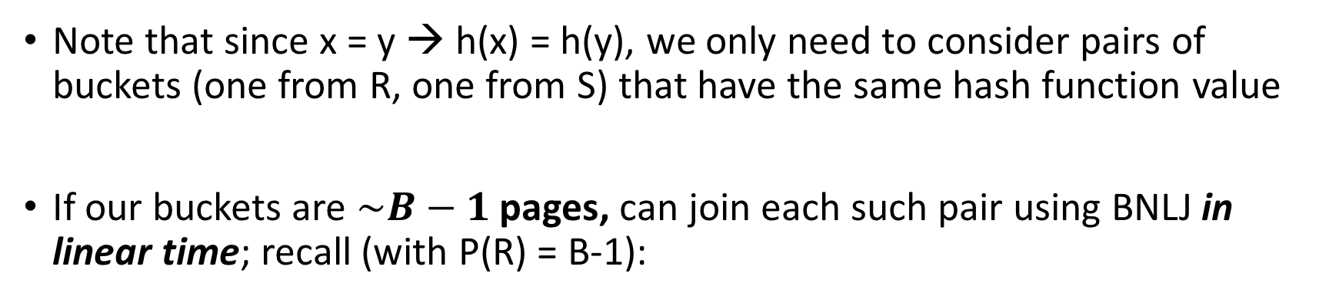
Hash Join Phase 2: Matching
Lecture 13 > Section 2 > HJ
Note that since x = y → h(x) = h(y), we only need to consider pairs of buckets (one from R, one from S) that have the same hash function value
If our buckets are $\sim B−1$ pages, can join each such pair using BNLJ in linear time; recall (with P(R) = B-1):
BNLJ Cost: $P\left(R\right)+ \frac{P\left(R\right)P(S)}{B−1}=P(R)+ \frac{(B−1)P(S)}{B−1}$ = P(R) + P(S)
Joining the pairs of buckets is linear!
(As long as smaller bucket <= B-1 pages)

Slide 59
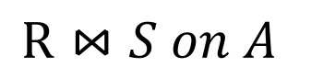
Hash Join Phase 2: Matching
Lecture 13 > Section 2 > HJ
h(1)=0
h(1)=0
h(2)=0
h(3)=1
h(3)=1
h(4)=1
h(5)=2
h(6)=2
h(6)=2
 | h(1) | h(1) | h(2) | h(2) | h(3) | h(4) | h(5) | h(6) | h(6)
$$R⋈S on A$$
R.A hashed values
S.A hashed values

Slide 60
Hash Join Phase 2: Matching
Lecture 13 > Section 2 > HJ
A=1
$$R⋈S on A$$
h(1)=0
h(1)=0
h(2)=0
h(3)=1
h(3)=1
h(4)=1
h(5)=2
h(6)=2
h(6)=2
 | h(1) | h(1) | h(2) | h(2) | h(3) | h(4) | h(5) | h(6) | h(6)
A=2
To perform the join, we ideally just need to explore the dark blue regions
= the tuples with same values of the join key A
A=3
R.A hashed values
A=4
A=5
A=6
S.A hashed values

Slide 61
Hash Join Phase 2: Matching
Lecture 13 > Section 2 > HJ
h(1)=0
h(1)=0
h(2)=0
h(3)=1
h(3)=1
h(4)=1
h(5)=2
h(6)=2
h(6)=2
 | h(1) | h(1) | h(2) | h(2) | h(3) | h(4) | h(5) | h(6) | h(6)
$$R⋈S on A$$
With a join algorithm like BNLJ that doesn’t take advantage of equijoin structure, we’d have to explore this whole grid!
R.A hashed values
S.A hashed values

Slide 62
Hash Join Phase 2: Matching
Lecture 13 > Section 2 > HJ
h(A)=0
$$R⋈S on A$$
h(1)=0
h(1)=0
h(2)=0
h(3)=1
h(3)=1
h(4)=1
h(5)=2
h(6)=2
h(6)=2
 | h(1) | h(1) | h(2) | h(2) | h(3) | h(4) | h(5) | h(6) | h(6)
With HJ, we only explore the blue regions
= the tuples with same values of h(A)!
h(A)=1
R.A hashed values
h(A)=2
S.A hashed values
We can apply BNLJ to each of these regions

Slide 63
Hash Join Phase 2: Matching
Lecture 13 > Section 2 > HJ
h'(A)=0
$$R⋈S on A$$
h'(A)=1
An alternative to applying BNLJ:
We could also hash again, and keep doing passes in memory to reduce further!
h'(A)=2
R.A hashed values
h'(A)=3
h'(A)=4
h'(A)=5
S.A hashed values

Slide 64
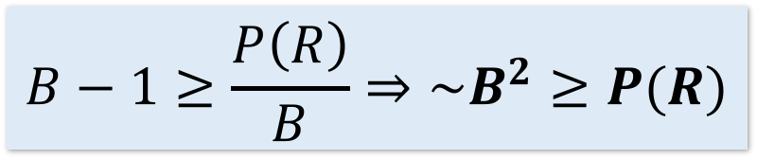
How much memory do we need for HJ?
Lecture 13 > Section 2 > Memory requirements
Given B+1 buffer pages
Suppose (reasonably) that we can partition into B buckets in 2 passes:
For R, we get B buckets of size ~P(R)/B
To join these buckets in linear time, we need these buckets to fit in B-1 pages, so we have:
+ WLOG: Assume P(R) <= P(S)
$$B−1≥\frac{P\left(R\right)}{B}⇒\sim B^{2}≥P(R)$$
Quadratic relationship between smaller relation’s size & memory!

Slide 65
Hash Join Summary
Lecture 13 > Section 2 > Memory requirements
Given enough buffer pages as on previous slide…
Partitioning requires reading + writing each page of R,S
→ 2(P(R)+P(S)) IOs
Matching (with BNLJ) requires reading each page of R,S
→ P(R) + P(S) IOs
Writing out results could be as bad as P(R)*P(S)… but probably closer to P(R)+P(S)
HJ takes ~3(P(R)+P(S)) + OUT IOs!

Slide 66
Bonus questions #2
Q1: Fast little dog.
If min {P(R), P(S)} < B² then HJ takes 3(P(R) + P(S)) + OUT
What is the similar condition to obtain 5(P(R) + P(S)) + OUT?
What is the condition for (2k+1)(P(R) + P(S)) + OUT
Q2: SMJ V. HJ
Under what conditions will HJ outperform SMJ?
Under what conditions will SMJ outperform SMJ?
Size of R, S and # of buffer pages
Discuss! And We’ll put up a google form.

Slide 67
3. The Cage Match
Lecture 13 > Section 3 > The Cage Match

Slide 68
Sort-Merge v. Hash Join
Lecture 13 > Section 3 > The Cage Match
Given enough memory, both SMJ and HJ have performance:
“Enough” memory =
SMJ: B² > max{P(R), P(S)}
HJ: B² > min{P(R), P(S)}
~3(P(R)+P(S)) + OUT
Hash Join superior if relation sizes differ greatly. Why?
Notes:
16

Slide 69
Further Comparisons of Hash and Sort Joins
Lecture 13 > Section 3 > The Cage Match
Hash Joins are highly parallelizable.
Sort-Merge less sensitive to data skew and result is sorted

Slide 70
Summary
Lecture 13 > Section 3 > The Cage Match
Saw IO-aware join algorithms
Massive difference
Memory sizes key in hash versus sort join
Hash Join = Little dog (depends on smaller relation)
Skew is also a major factor
Message: The database can compute IO costs, and these are different than a traditional system

